Slide 1
Appraisal update
NHS England (Severn)
Maurice Conlon FRCGP
National Appraisal Lead
23 April 2013

Slide 2
Outline
Revalidation: governance, plan, and place of appraisal
Appraisal: guidance, purpose, policy
Quality assurance: framework, network and working towards consistency
So what? A little bit of philosophy
A sense of there being a plan and a work in progress.

Slide 3
First, a thought to begin:
It’s all about safety and quality of care received by patients…

Slide 4
Outline
Revalidation: governance, plan, and place of appraisal
Appraisal: guidance, purpose, policy
Quality assurance: framework, network and working towards consistency
So what? A little bit of philosophy

Slide 5
Revalidation:
The process by which the GMC confirms continuation of a doctor’s license to practice in the UK
All doctors who wish to retain their licence to practice must participate
Aims to provide greater assurance to patients and the public, employers and other healthcare professionals that licensed doctors are up-to-date and fit to practice
Will contribute towards improved patient safety and quality of care by driving improvements in clinical governance

Slide 6
Revalidation:
Based on local evaluation of doctors’ practice through appraisal
Each doctor has a prescribed connection with an organisation and relates to a senior doctor in the organisation, the responsible officer
Doctors will need to participate in annual appraisals and collect supporting information over the course of 5 years
Based on the outcome of this, the responsible officer makes a recommendation about the doctor’s fitness to practice to the GMC
The GMC decides whether to revalidate

Slide 7
Revalidation – High level Governance
GMC UK Revalidation Implementation Advisory Board (RIAB)
UK
Department of Health (ERD SMY)
Revalidation Programme Board (RPB)
‘All’ England
As ‘SRO’
All England Revalidation Operational Network
NHSE Quality & Clinical Risk Committee
NHSE Board
Stakeholder Reference Group
Responsible Officer Calibration and Operational Network (ROCON)
NHS England
As a ‘DB’
Revalidation Programme & Work stream
Programme Management Office (PMO)
Business Planning
Responding to concerns
Information Management & Technology (IM&T)
Framework for Quality Assurance
Medical Appraisal

Slide 8
Programme Structure
Responding to Concerns
Unified policy and standardised approach for responding to concerns (including remediation)
Information Management & Technology
To select and develop an information management tool to support NHS England responsible officers in the execution of their revalidation responsibilities.
Medical Appraisal
To develop policies, guidance and templates which continuously improve the quality and consistency of medical appraisals.
Programme Management Office
Quality Assurance
Framework giving assurance that designated bodies are complying with the RO regulations
Business Planning
To ensure that adequate resources, plans and funding is in place for 2014/15 & 2015/16
Stakeholder Engagement and Communications
Benefits Realisation Plan
Notes:
8

Slide 9
Programme Structure
Responding to Concerns
Unified policy and standardised approach for responding to concerns (including remediation)
Information Management & Technology
To select and develop an information management tool to support NHS England responsible officers in the execution of their revalidation responsibilities.
Medical Appraisal
To develop policies, guidance and templates which continuously improve the quality and consistency of appraisals.
Programme Management Office
Quality Assurance
Framework giving assurance that designated bodies are complying with the RO regulations
Business Planning
To ensure that adequate resources, plans and funding is in place for 2014/15 & 2015/16
Stakeholder Engagement and Communications
Benefits Realisation Plan
Notes:
9

Slide 10
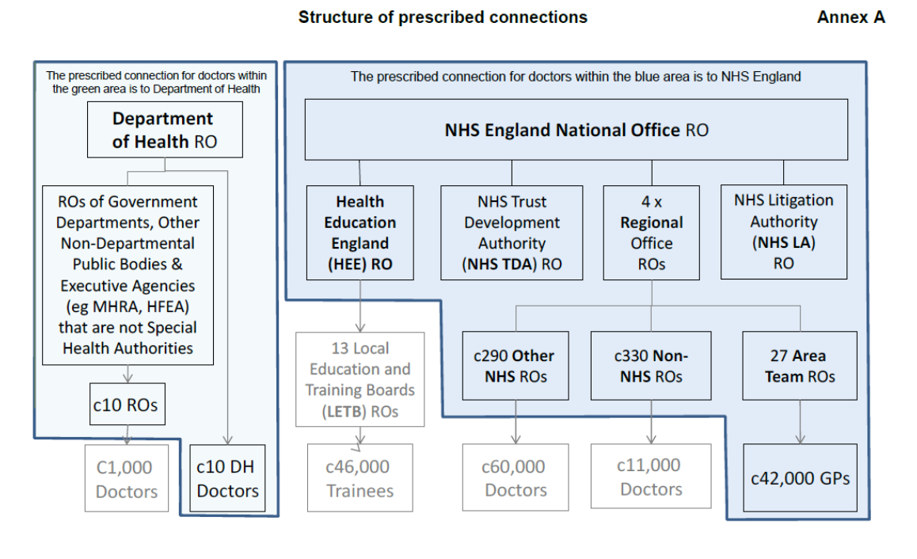
NHS England as DB and as SRO

Slide 11
Outline
Revalidation: governance, plan, and place of appraisal
Appraisal: guidance, purpose, policy
Quality assurance: framework, network and working towards consistency
So what? A little bit of philosophy

Slide 12
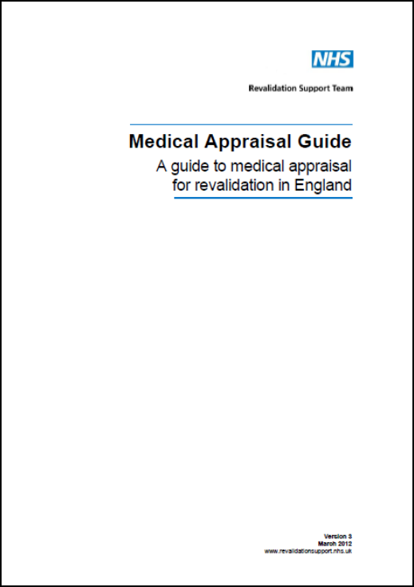
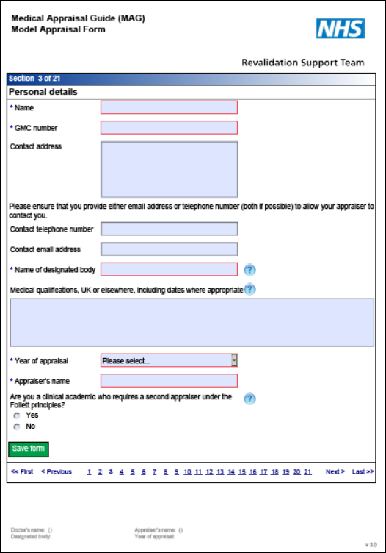
Medical Appraisal Guide and Form

Slide 13


Other essential reading:

Slide 14
Purposes of appraisal:
To enable doctors to discuss their practice and performance with their appraiser in order to demonstrate that they continue to meet the principles and values set out in the GMC document Good Medical Practice and thus to inform the responsible officer’s revalidation recommendation to the GMC.
To enable doctors to enhance the quality of their professional work by planning their professional development.
To enable doctors to consider their own needs in planning their professional development.
And may also be used
To enable doctors to ensure that they are working productively and in line with the priorities and requirements of the organisation they practise in.
NHS Revalidation Support Team Medical Appraisal Guide v4, March 2013

Slide 15
Outputs of appraisal:
MAG Appraiser statements
Appraisal summary
New PDP

Slide 16
Appraiser statements:
An appraisal has taken place that reflects the whole of a doctor’s scope of work and addresses the principles and values set out in Good Medical Practice.
Appropriate supporting information has been presented in accordance with the Good Medical Practice Framework for Appraisal and Revalidation and this reflects the nature and scope of the doctor’s work.
A review that demonstrates progress against last year’s personal development plan has taken place.
An agreement has been reached with the doctor about a new personal development plan and any associated actions for the coming year.
No information has been presented or discussed in the appraisal that raises a concern about the doctor’s fitness to practise.

Slide 17

NHS England Medical Appraisal Policy:
> 300 PCT appraisal policies
Covers GPs, and ROs and doctors employed by NHS England
Underpinned by Medical Appraisal Guide, Quality Assurance of Medical Appraisers and Information Management for Revalidation in England
Significant benefits in terms of consistency and quality
Signed off October 2013; fully functional April 2014
One NHS England medical appraisal policy

Slide 18
NHS England Medical Appraisal Policy:
Backed up by tools, including:
Process description with timescales
Templates for:
- appraisal postponement requests
- conflict of interest applications
- management of non-participation.

Slide 19
Outline
Revalidation: governance, plan, and place of appraisal
Appraisal: guidance, purpose, policy
Quality assurance: framework, network and working towards consistency
So what? A little bit of philosophy

Slide 20
Framework for Quality Assurance (FQA)
Responding to Concerns
To ensure there is a unified policy and standardised approach for responding to concerns (including remediation) within NHS England
Information Management & Technology
To select and develop an information management tool to support NHS England responsible officers in the execution of their revalidation responsibilities.
Medical Appraisal
To develop policies, guidance and templates which continuously improve the quality and consistency of medical appraisals.
Programme Management Office
Quality Assurance
To develop & implement a framework giving assurance that designated bodies are complying with the RO regulations
Responsible Officers
To develop & provide tools and templates to assist Responsible Officers in carrying out their duties
Business Planning
To ensure that adequate resources, plans and funding is in place for 2014/15 & 2015/16
Stakeholder Engagement and Communications
Benefits Realisation Plan
Notes:
20

Slide 21
The chain of FQA:
1 Quarterly reporting feeds into:
  2 Annual organisational Audit (AOA), which feeds into:
3 Annual report, which feeds into:
4 Board statement of compliance with regulations.
AOA is the key, and assesses:
RO mechanics
Appraisal
Monitoring performance and responding to concerns
Pre-employment checks

Slide 22
QA Appraisal Headlines in AOA:
Appraisal policy
Audit of appraisal rates
Exception audit of appraisals not done
QA of appraisal inputs and outputs
Supporting information
Sufficient appraiser capacity
Appraisers trained and supported

Slide 23
Fundamental to quality:
Quantity
Provide appraisal for all doctors
Quality
Provide good appraisal

Slide 24
All England Appraisal Network:
Local (circa 650 designated bodies)
Regional (The leads from each designated body)
National (The regional leads)
Communication feeds both ways.
It means your local lead has a conduit to the regional level.
Meetings develop shared blueprint:
Topical update
‘Bring and borrow’
Scenario discussion

Slide 25
Working towards consistency:
The Big List of Appraisal Issues
Top themes:
Supporting information
Mechanics/timings
Appraiser assurance and support
Information governance
Appraisal training for doctors

Slide 26
Outline
Revalidation: governance, plan, and place of appraisal
Appraisal: guidance, purpose, policy
Quality assurance: framework, network and working towards consistency
So what? A little bit of philosophy

Slide 27
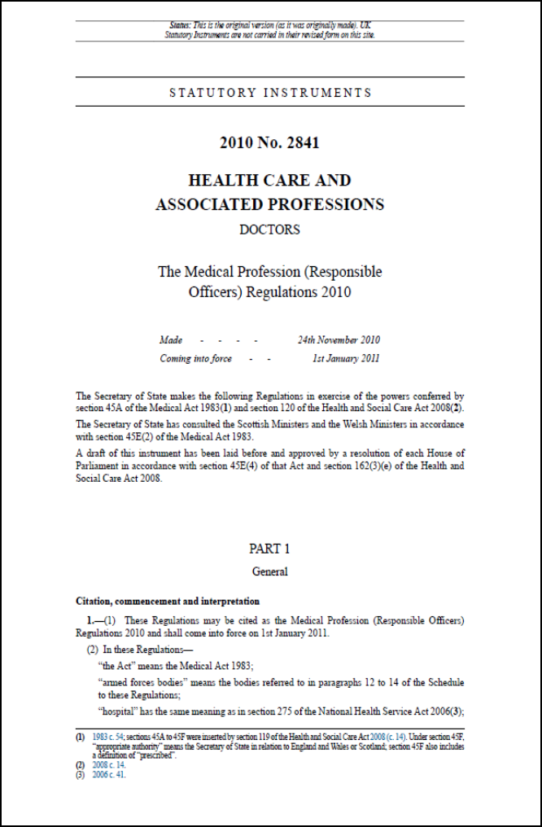
So what’s happening?
January 2011 – everything changed

Slide 28
NHS England Medical Appraisal Policy:
January 2011 – everything changed
December 2012 – the change was consolidated
– the revalidation regulations commenced.

Slide 29
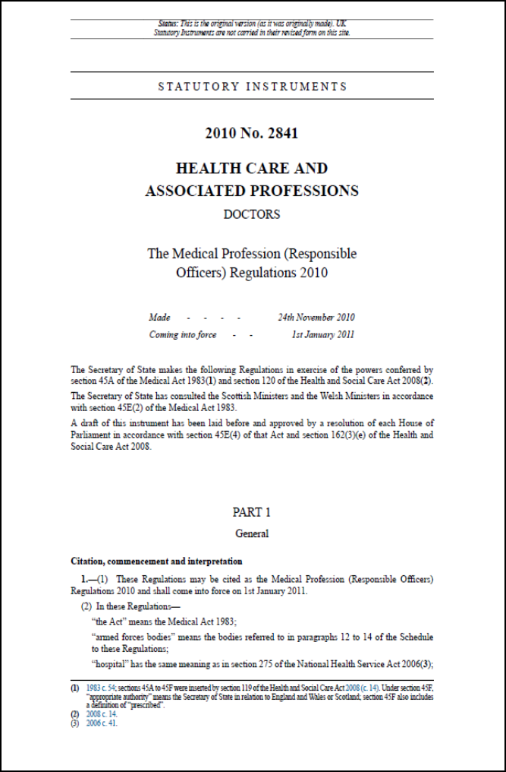
And the change is?
A universal process of supervision and support for doctors, centred on appraisal and clinical governance
Formal input from patients into licensing process
Obligation on organisations to provide supervision and support
- All underpinned by statute.

Slide 30

NHS England Medical Appraisal Policy:
The Responsible Officer
Regulations and Guidance
The role covers:
Contracts of employment or for provision of services
Communicating with the GMC
Monitoring conduct and performance
Evaluation of fitness to practise
Appraisal
Responding to concerns

Slide 31
And what does all that mean?
Doctors: must “give” supervision to gain support
Patients: must “give” tolerance of imperfection to gain influence
Organisations: must “give” support to gain supervision
Independent practice becomes interdependent practice

Slide 32
So what?
Be patient: current focus is on mechanics
Next stage is to make something of the journey
End goal is something different

Slide 33
…because in the end…
…it’s all about safety and quality of care received by patients.
www.england.nhs.uk/revalidation
maurice.conlon@nhs.net

